Slide 1
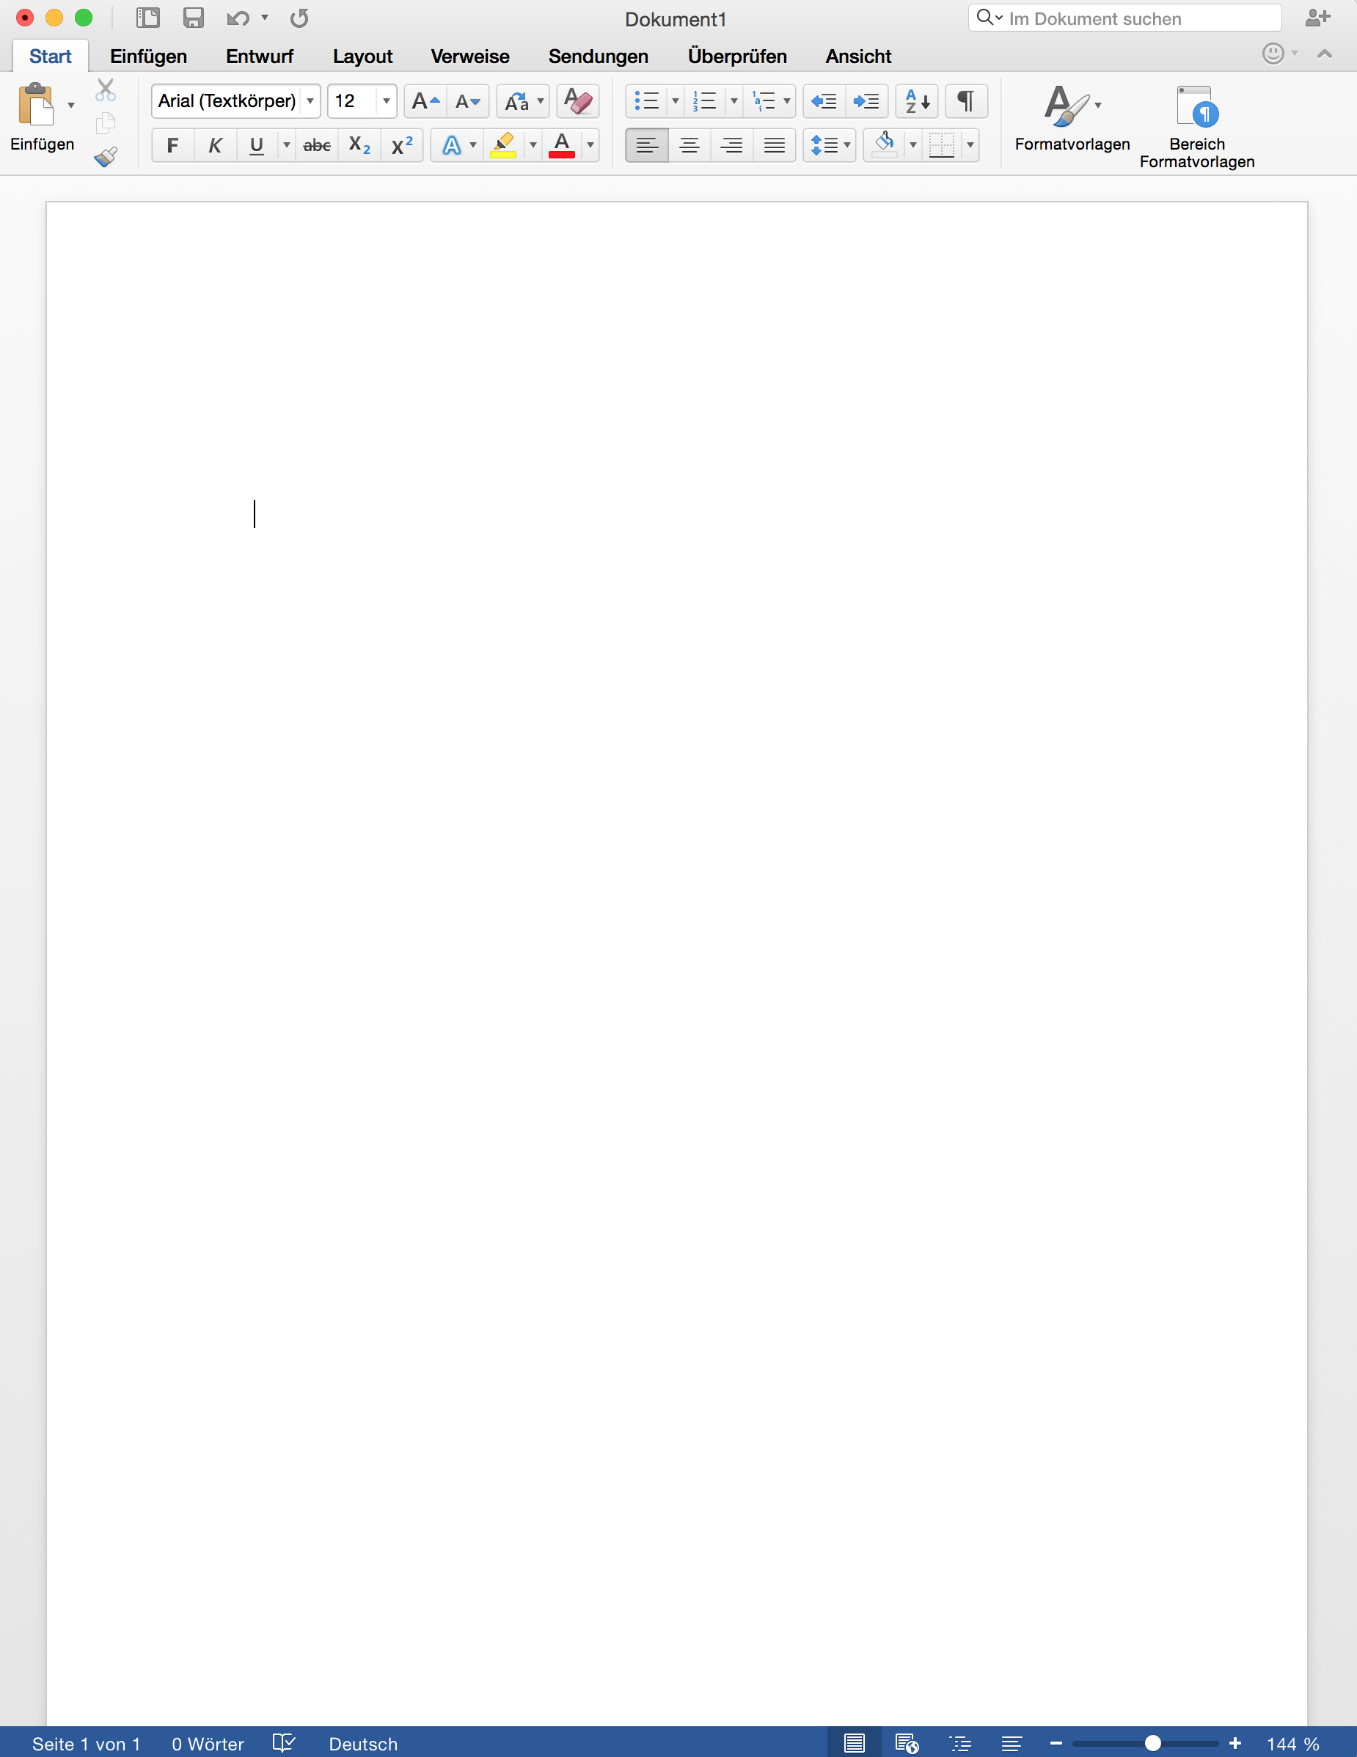
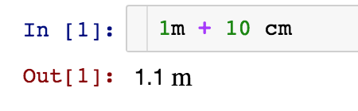
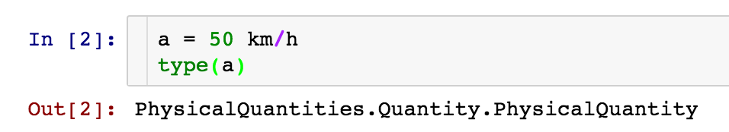
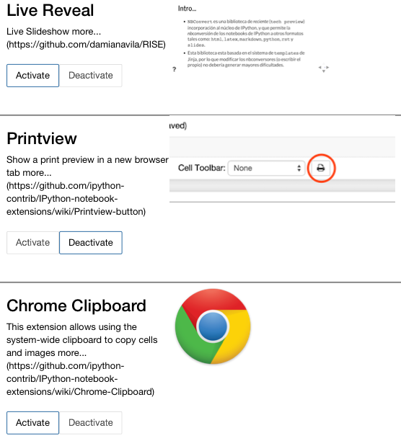
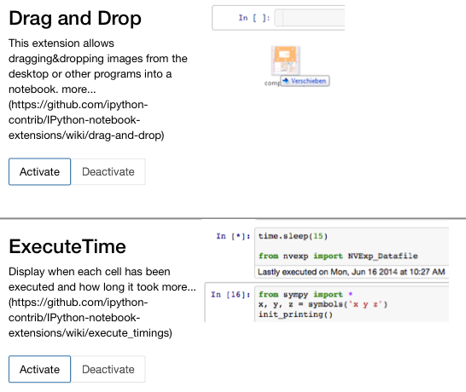
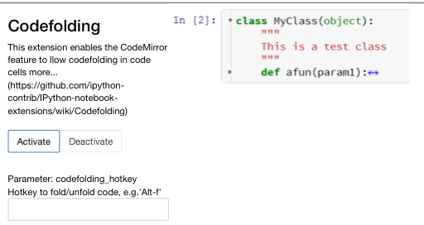
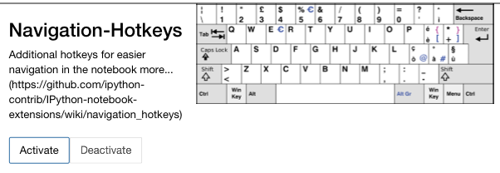
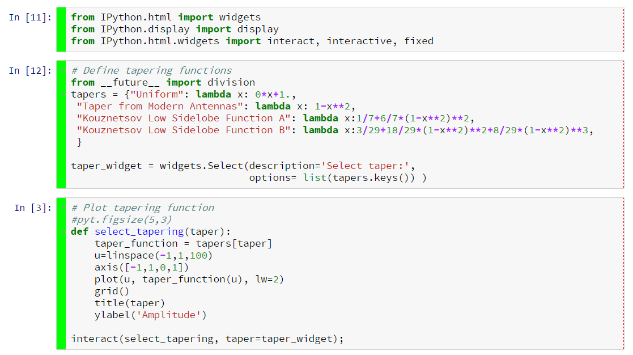
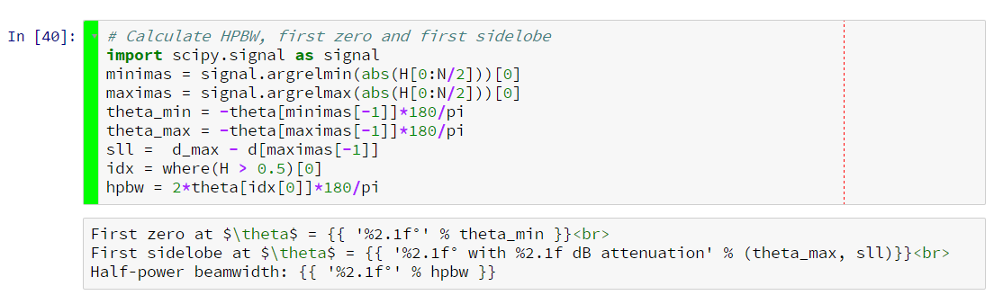
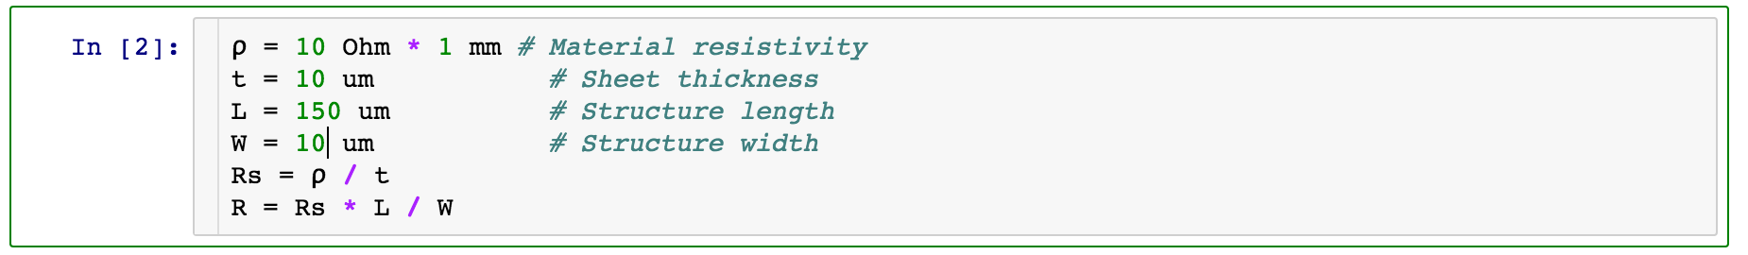
Using the IPython Notebook as Lab Notebook
Jürgen Hasch, juergen.hasch@elbonia.de
Abstract
Computer Tools
Customization
Another Example
The IPython (Jupyter) notebook comes very close to the ideal electronic version of an engineer’s lab notebook. It is easy to use, allows combining text, formulas, graphics, plots and tables, can do live calculations, and can be used to generate static documentation. Customizing the notebook with extensions significantly improves the workflow.
Word: The main tool being used even nowadays is Microsoft Word. Shocking but true. For calculations and generating plots, additional tools like Matlab are used.
Mathematica: A powerful tool geared towards mathe-matical formulation of problems. It is not easy to use (think: pencil and paper), unless one spends considerable time learning it.
Mathcad: Explicitly designed as engineering tool. Allows putting in formulas in mathematical notation and doing actual calculations. My experience: Limited capabilities, closed to the outside world, bugs.
IPython notebook: Allows combining text, formulas, and graphics. And gives you the power if Python.
IPython extension ‘PhysicalQuantities’
Notebook extensions
Hiding cells
Motivation
Widgets
Scientists and engineers keep a lab notebook to write down new ideas, do simple calculation or document measurements.
It is still the single most important tool, and often the primary means of documentation, even in the computer age. The picture shows a page of Enrico Fermi's lab notebook:
Example
Graphics
Formulas
Calculation
Under the Hood
Results
Widgets
Python in markdown
Entries in a lab notebook typically contain a heading, the current date, text, tables, math, drawings, and calculations.
As computers have become an integral part of research and engineering, having a computer-based tool that essentially allows the same workflow as with a handwritten lab note-book becomes inevitable. The proper tool…
Is easy to use (think pencil and paper)
Can do text, formulas, graphics, plots, tables
Can do calculations
Can be reused
Is useful for documentation
The Python Ecosystem
So what makes Python and the IPython notebook a good choice ?
Python is a modern general-purpose language with a focus on making it fast and easy to use.
The ecosystem: There's a package for that! For mathematics, plotting, optimization, data formats, internet protocols.
The notebook frontend running in a web browser.
The extensibility: IPython extensions allow adding functionality to the interpreter and the frontend.
Plotting
Under the Hood
Graphics
Formulas
Calculation
Output in Markdown
Wish List
Hierarchy, allow to collapse parts of a notebook
Keep notebook and data together ('projects’)
Versioning, visual diffing
Templates based on existing notebooks
Easy Export into something ‘looking good’

